Slide 1

Binary to gray code conversion and vice versa

Slide 2
What is Gray Code … ?
The gray code is a non-weighted code. The successive gray code differs in one bit position only that means it is a unit distance code. It is also referred as cyclic code.

Slide 3
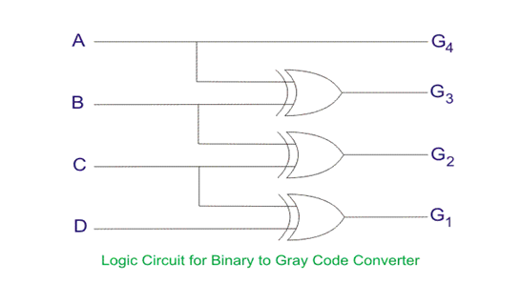
Binary to gray code converter
Binary inputs |  |  |  | Gray outputs
A | B | C | D | G₄ | G₃ | G₂ | G₁
0 | 0 | 0 | 0 | 0 | 0 | 0 | 0
0 | 0 | 0 | 1 | 0 | 0 | 0 | 1
0 | 0 | 1 | 0 | 0 | 0 | 1 | 1
0 | 0 | 1 | 1 | 0 | 0 | 1 | 0
0 | 1 | 0 | 0 | 0 | 1 | 1 | 0
0 | 1 | 0 | 1 | 0 | 1 | 1 | 1
0 | 1 | 1 | 0 | 0 | 1 | 0 | 1
0 | 1 | 1 | 1 | 0 | 1 | 0 | 0
1 | 0 | 0 | 0 | 1 | 1 | 0 | 0
1 | 0 | 0 | 1 | 1 | 1 | 0 | 1
1 | 0 | 1 | 0 | 1 | 1 | 1 | 1
1 | 0 | 1 | 1 | 1 | 1 | 1 | 0
1 | 1 | 0 | 0 | 1 | 0 | 1 | 0
1 | 1 | 0 | 1 | 1 | 0 | 1 | 1
1 | 1 | 1 | 0 | 1 | 0 | 0 | 1
1 | 1 | 1 | 1 | 1 | 0 | 0 | 0

Slide 4
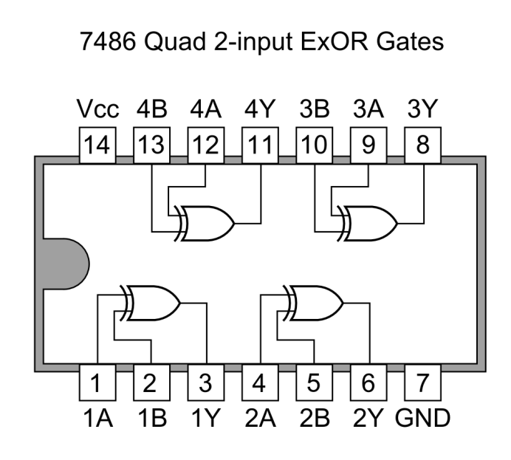
IC Required : 7486(Ex-OR Gate)

Slide 5
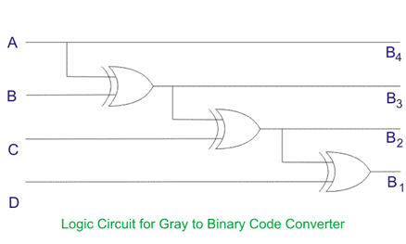
Gray to Binary code converter
Gray inputs |  |  |  | Binary outputs
A | B | C | D | B₄ | B₃ | B₂ | B₁
0 | 0 | 0 | 0 | 0 | 0 | 0 | 0
0 | 0 | 0 | 1 | 0 | 0 | 0 | 1
0 | 0 | 1 | 1 | 0 | 0 | 1 | 0
0 | 0 | 1 | 0 | 0 | 0 | 1 | 1
0 | 1 | 1 | 0 | 0 | 1 | 0 | 0
0 | 1 | 1 | 1 | 0 | 1 | 0 | 1
0 | 1 | 0 | 1 | 0 | 1 | 1 | 0
0 | 1 | 0 | 0 | 0 | 1 | 1 | 1
1 | 1 | 0 | 0 | 1 | 0 | 0 | 0
1 | 1 | 0 | 1 | 1 | 0 | 0 | 1
1 | 1 | 1 | 1 | 1 | 0 | 1 | 0
1 | 1 | 1 | 0 | 1 | 0 | 1 | 1
1 | 0 | 1 | 0 | 1 | 1 | 0 | 0
1 | 0 | 1 | 1 | 1 | 1 | 0 | 1
1 | 0 | 0 | 1 | 1 | 1 | 1 | 0
1 | 0 | 0 | 0 | 1 | 1 | 1 | 1

Slide 6
IC Required : 7486(Ex-OR Gate)

Slide 7
Thank You...

